Slide 1
Should you work as a SF government Employee?
An analysis of Data from <data>

Slide 2
Audience
Main : Potential candidates for SF government positions
Others:
Policy makers who decide the pays of these employees
Labor Unions
Realtors

Slide 3
Is moving to SF as a SF government employee a wise financial decision?
Factors to consider
Average Pay for the job title you seek
Average Pay based on your attributes
Cost of living – rent/mortgage, commute
Lifestyle – Work hours, traffic
Surrounding cities- comparison
Similar job – non-government companies

Slide 4
About the Data
Variables
Title
Base Pay
Over time
Year
TotalPay

Slide 5
Other Data
Home median prices by zipcode
Average school ratings by zipcode
User Input data – like number of children, or bedrooms

Slide 6
Comparison With Other Employees

Slide 7
Pay Scale for similar Job Titles

Slide 8
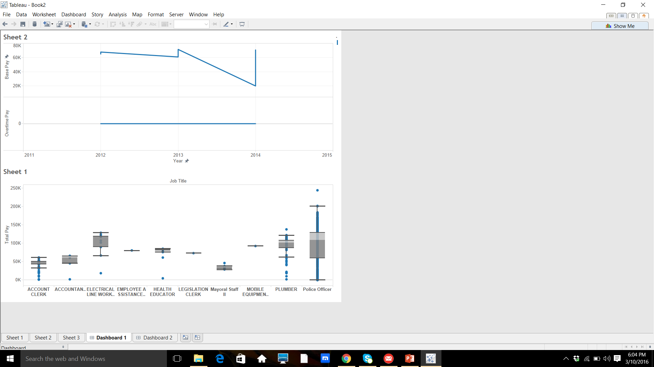
Job titles -> Ratio of base/overtime 2011-2015

Slide 9
testing plan
Ask editors, columnist , journalist and realtors for their feedback
Ask friends on Facebook
Consider the time and ease/skill to work on each suggestion
Consider if the suggestion would explain the data better

Slide 10
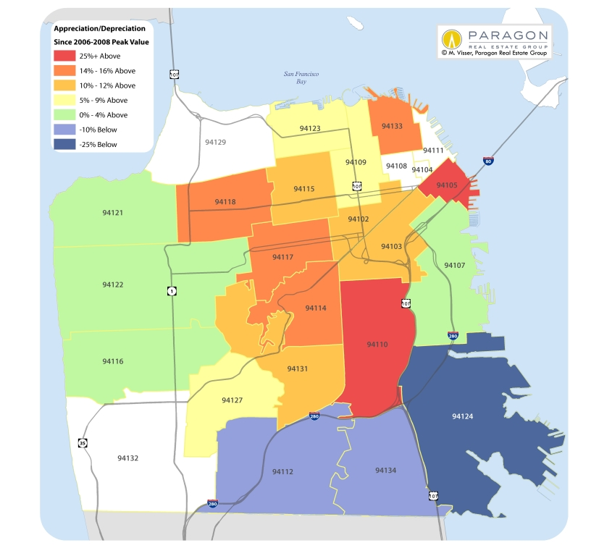
Show (heat map) How Much It Will Cost You
Average home Price
Average Bedreooms
School Scores
FILTERS:
Job Title, Base Pay, Total Pay:
Additional:
Overtime – where would be with average OT

